Slide 1
Full Stack Web Development
Sass / Getting Started

Slide 2
What Is Sass?
Syntactically Awesome StyleSheets
Sass is a CSS preprocessor which is a scripting language that extends CSS by allowing developers to write code in one language and compile it into CSS
Can use .sass and .scss file extensions
Others include LESS and Stylus

Slide 3
What Can Sass Do?
Variables in CSS
Nesting Styles
Partials
Importing CSS Files
Mixins
Extending & Inheritance
Perform Operations & Calculations

Slide 4
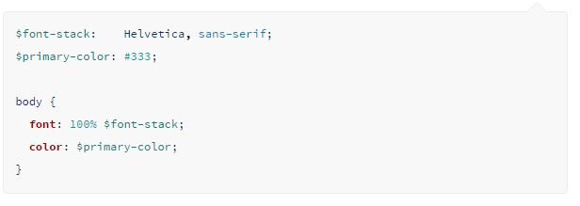
Variables
We can use variables in CSS as we would use in true programming langauges
Variables use the $ symbol

Slide 5
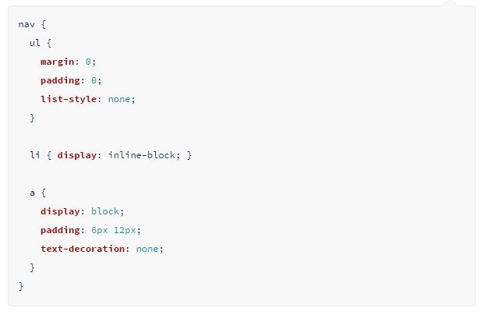
Nesting
We can now nest css styles as we can HTML elements

Slide 6
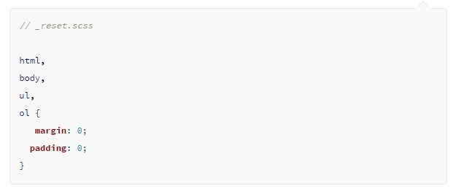
Partials & Importing
We can create modular files to include in other Sass files. This makes things really easy to maintain.
A partial is simply a Sass file named with a leading underscore
We can import using //

Slide 7
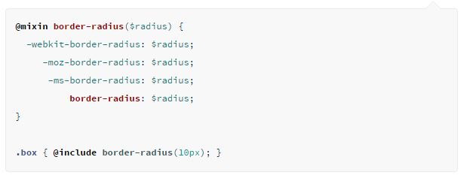
Mixins
Group together CSS declarations to be used throughout the site
Values can be passed into a mixin
Essentially a CSS function

Slide 8
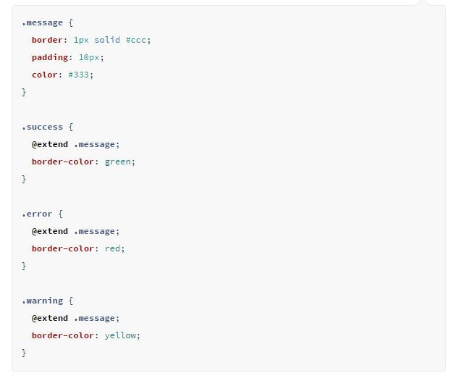
Extend & Inheritance
Extend properties from one
selector to another

Slide 9
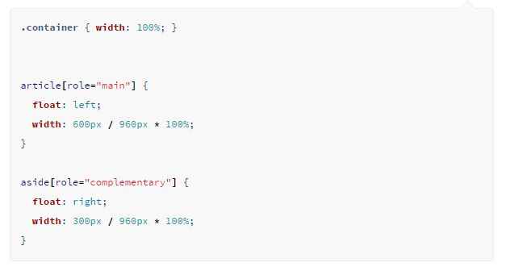
Operators
Standard math operators are available in Sass

Slide 10
Compiling Sass
Applications – Coedit, Compass.app, Koala, Scout, Ghostlab
Command Line – Linux/ Windows/ Mac – Need Ruby Installed
Runtime – Using a task runner like Grunt or Gulp

Slide 11


